Slide 1
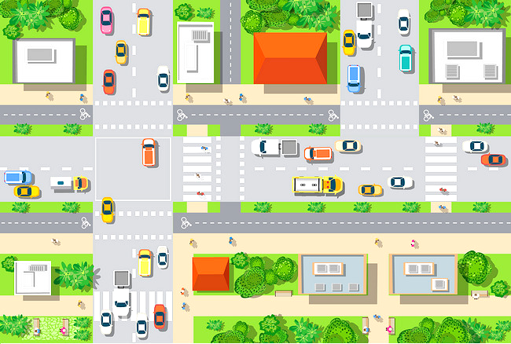
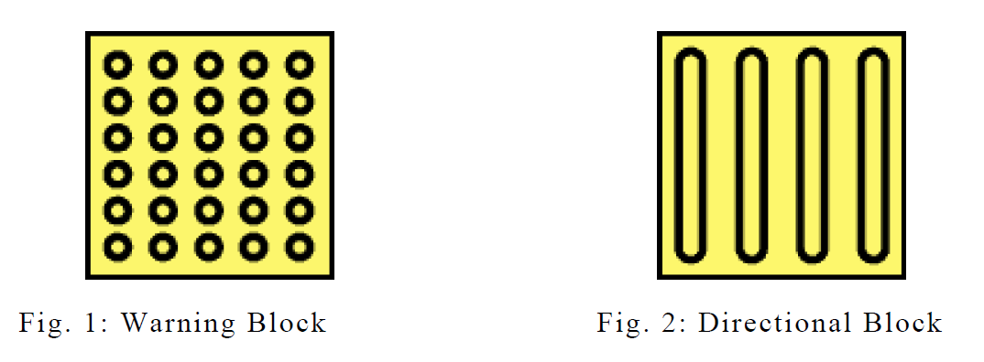
Tactile City
No detectable warning tiles (blind die) – Design tactile city for visual impairment people - Education
Notes:
Goal: Guide blind and visual impaired people through public spaces
No detectable warning tiles → people die
Select right tiles and right audio signals to build tactile city (wrong tiles would hurt others)
Solve other problems which may lead to blind people afraid of going out
Discrimination
No job
No education

Slide 2
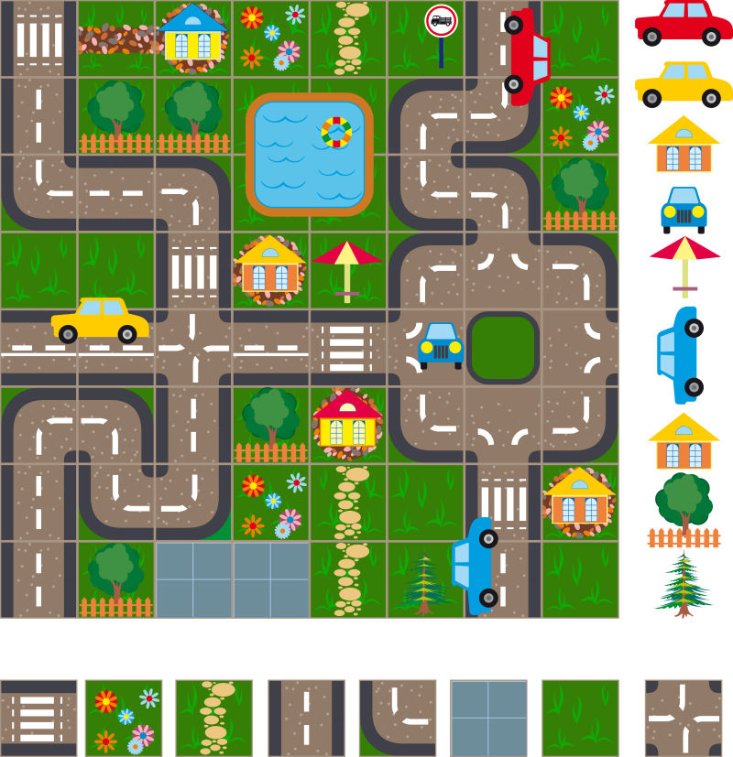
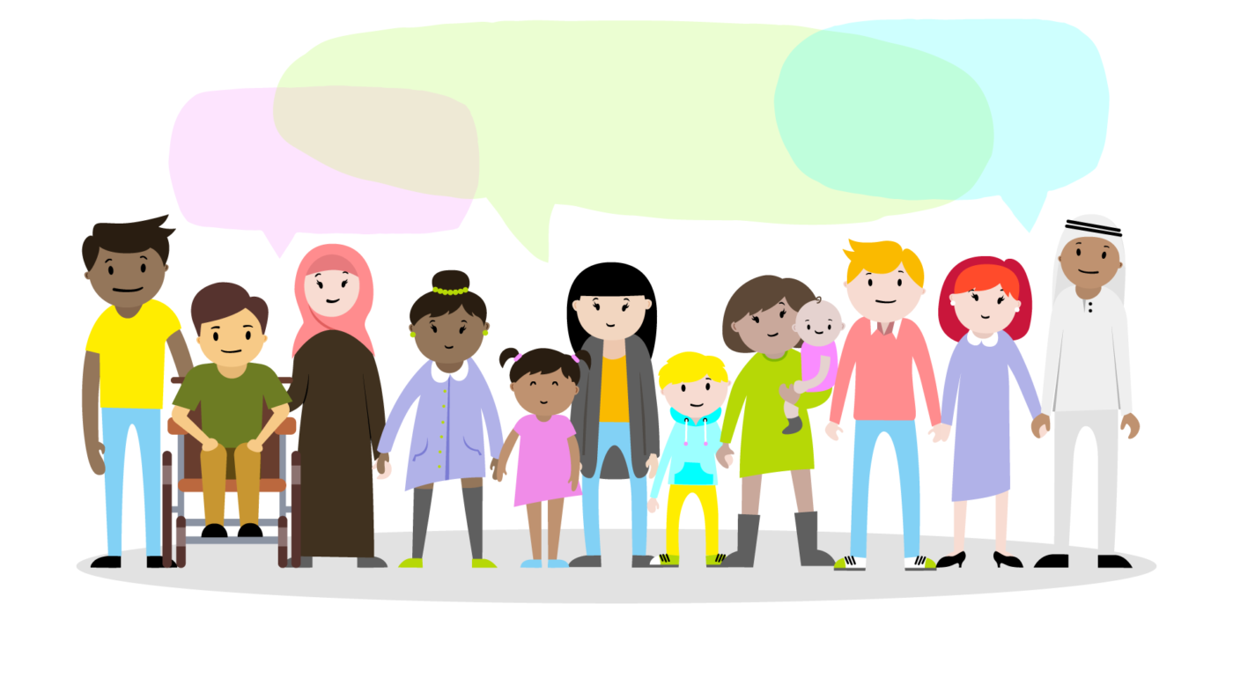
Tactile City
No detectable warning tiles (blind die) – Design tactile city for visual impairment people - Education
Speech：
No discrimination
More Job

Slide 3
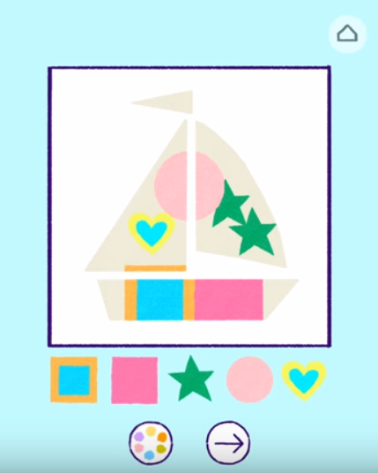
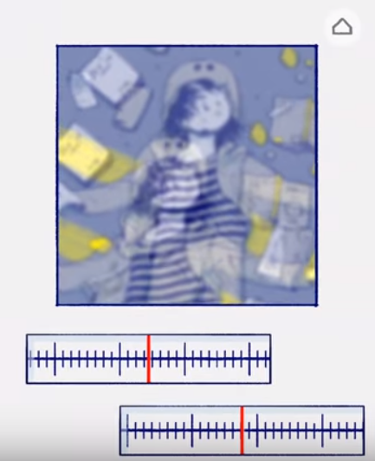
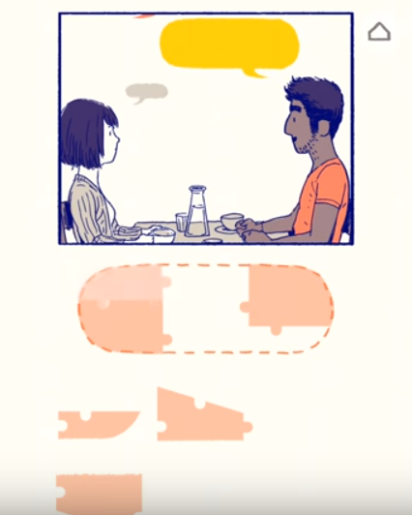
Interactive Prose
Choose a story – interactive storytelling

Slide 4

Wedding
Love story – choose elements to prepare for wedding - Grading
Notes:
Change background(drawing machine)
Personality: cute-animal, beautiful-flower…

Slide 5
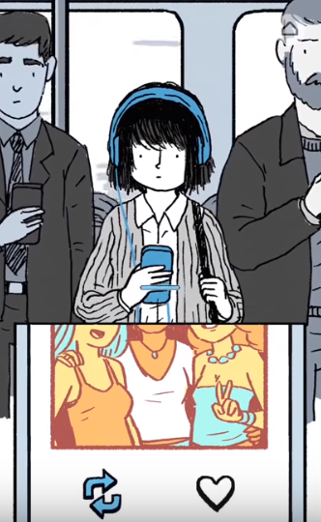
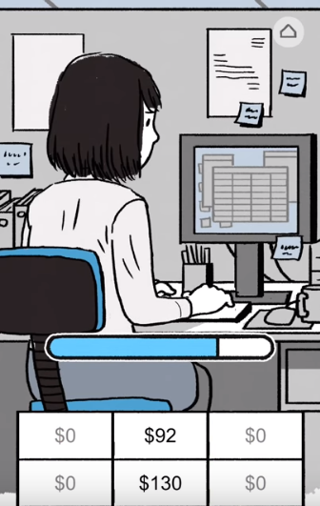
How long will you live
Test – Calculate – Plan for you life – Animation – Show your parents’ life time – Plan for your life - Animation
Estimated(yourself)
Left(yourself)
To be a baseball player
Write novels
Travel around the world
Start my own business
Save money

Slide 6
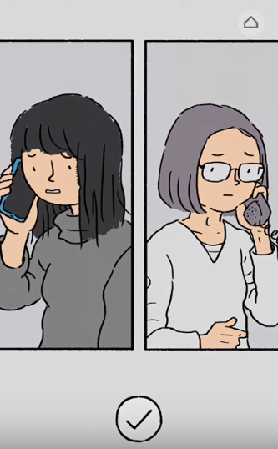

How long will you live
Test – Calculate – Plan for you life – Animation – Show your parents’ life time – Plan for your life - Animation
Estimated(yourself)
Left(yourself)
Left(mother)
Left(father)
Go home and visit parents！
Call parents

